Slide 1

Outlook
A Project Submitted
in Partial Fulfillment of the Requirements
for the Degree of
BSc (CS)
By
Pankaj Jyani (1606010001973)
Naman Gupta (1606010001956)
DEPARTMENT OF COMPUTER SCIENCE
KERAL VERMA SUBHARTI COLLEGE OF SCIENCE
SWAMI VIVEKANAND SUBHARTI UNIVERSITY, MEERUT (U.P)
March, 2019

Slide 2
OUTLOOK
WHAT IS OUTLOOK?
OutLook is basically a mailing application through which we can send and receive Emails and we also can save it by just only login in the application.

Slide 3
HOW OUTLOOK IS DIFFERENT FROM OTHER MAILING APPLICATION
In other mailing application we can just send and receive mails by just text mailing but in this application we can write mail by text written and by voice command as well…

Slide 4
PURPOSE OF OUTLOOK
Currently people do mails by typing mail personally or write it properly or enter whole mail by manually and sending it by login or connecting it by any other applications or by making links to other mailing sites portals or other mailing applications which is very difficult for blind peoples and very time consuming for all.
Proposed Outlook mailing system will eliminate some manual intervention and increase the speed of whole process. System will allow peoples to send mails by voice command or by typing as well. After successful submission of login and password, you can choose that weather you want to write your mail personally or by voice command. Person can login into system by using login Id and password. System will show the result after instantly and stored the results for further use.

Slide 5
FEATURES OF OUTLOOK
Outlook mailing System –is complete software which help us to write mails by voice command and by writing as well and we can also send email by without login any other applications or sites only we have to login into the OutLook application.

Slide 6
INTERFACE OF OUTLOOK

Slide 7
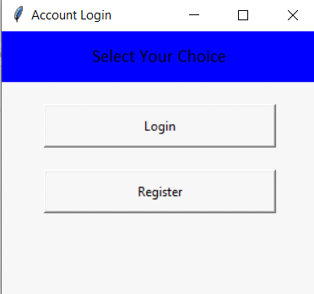
ACCOUNT LOGIN
In the login page you will see two options one is for login and another for register

Slide 8
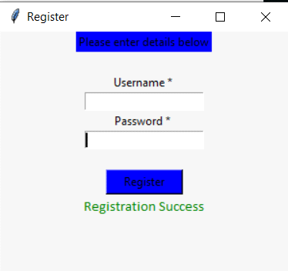
Register Screen

Slide 9
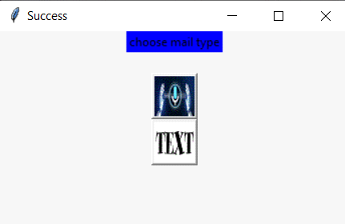
Send Mail

Slide 10
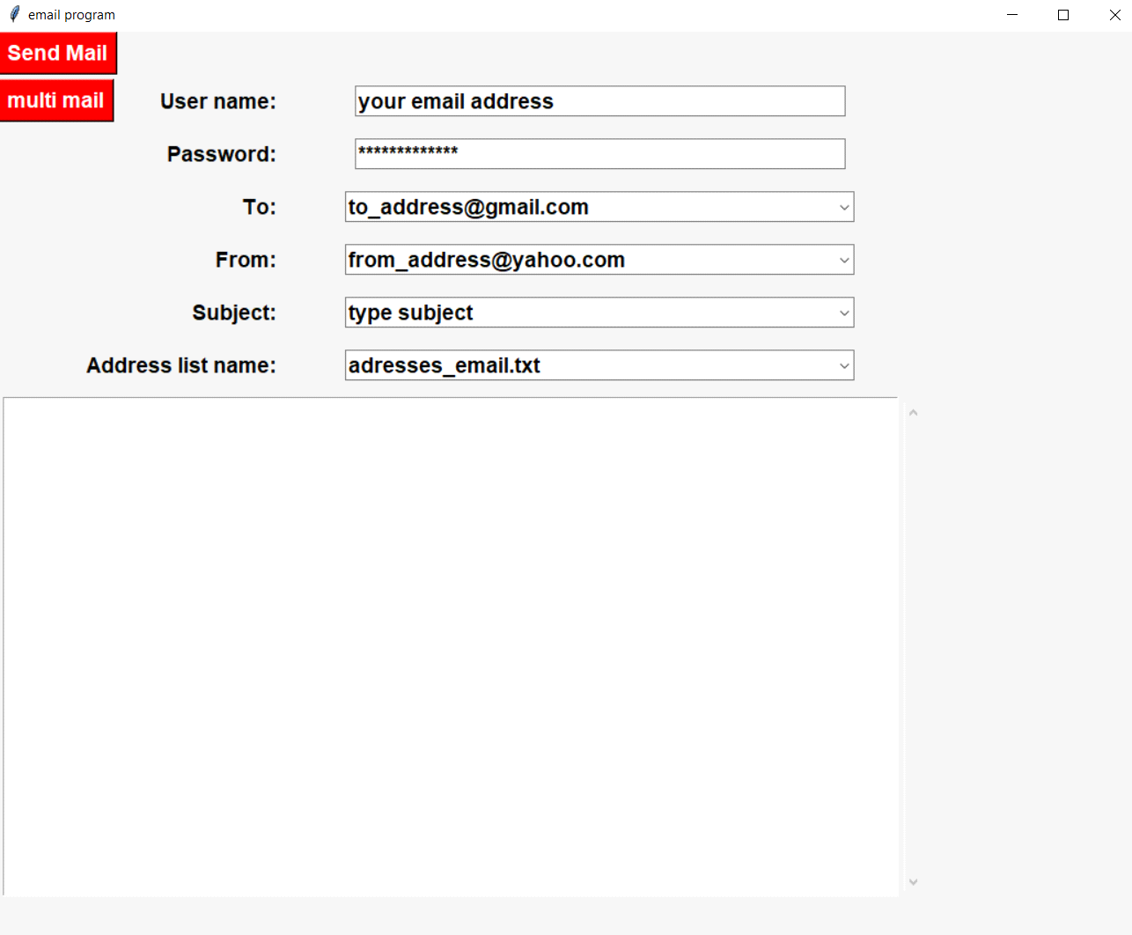
TEXT MAIL SCREEN

Slide 11
RECEIVE MAIL MAIN SCREEN

Slide 12
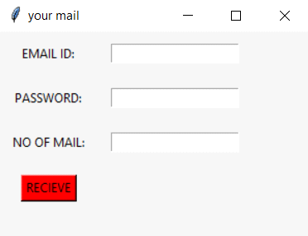
RECIEVE TEXT MAIL SCREEN

Slide 13
THANK YOU

